Slide 1
Capstone project 1
Analysis of airline passenger Satisfaction over airlines services

Slide 2

Passenger satisfactions plays a huge role in the reputation of the airline organization.
To efficiently acquiring more passengers, it is imperative to understand the passenger satisfaction over airlines services.

Slide 3
Data source
Kaggle
Link : https://www.kaggle.com/datasets/mikhail1681/airline-quality-ratings?resource=download

Slide 4
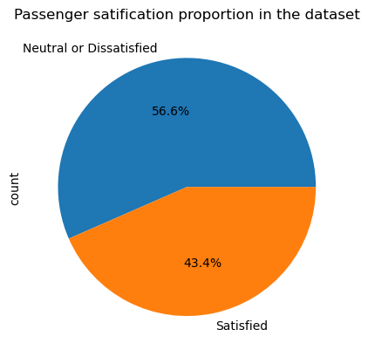
Passenger satisfaction percentile for the given data
The passenger satisfaction rate, calculated at 43.4% from the provided data,
indicates that out of every hundred passengers, approximately
43 expressed satisfaction with the airline services.

Slide 5
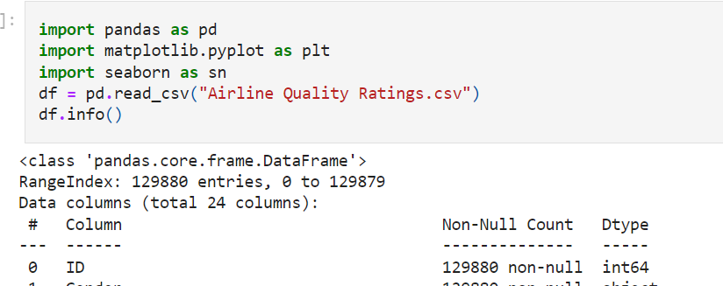
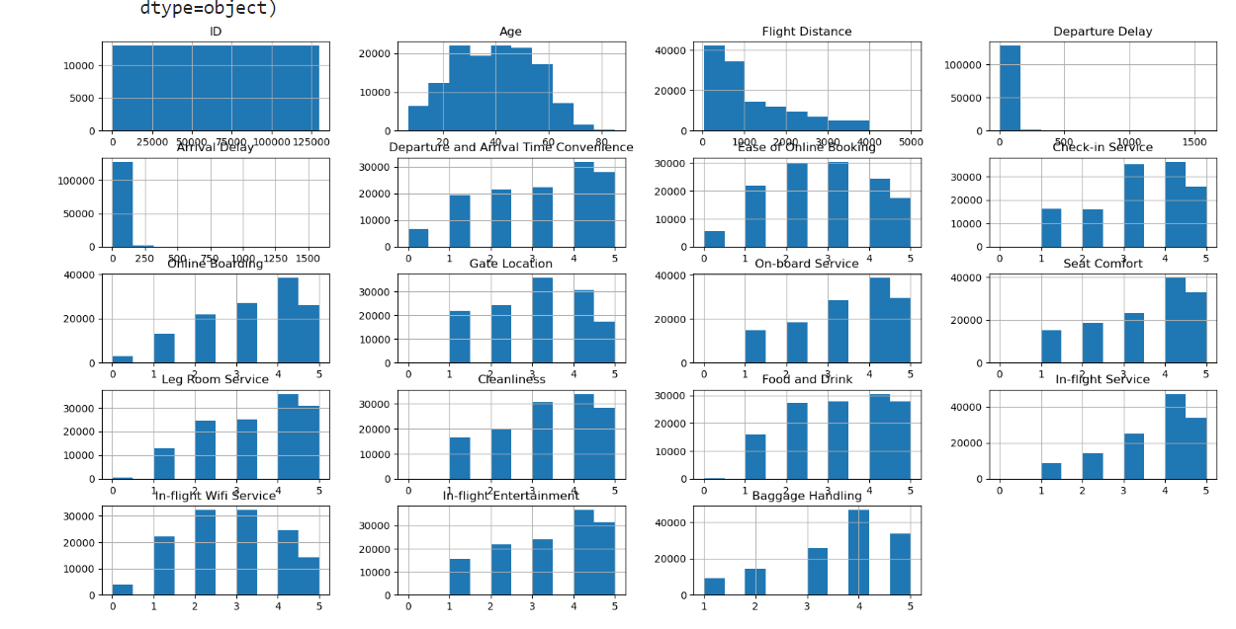
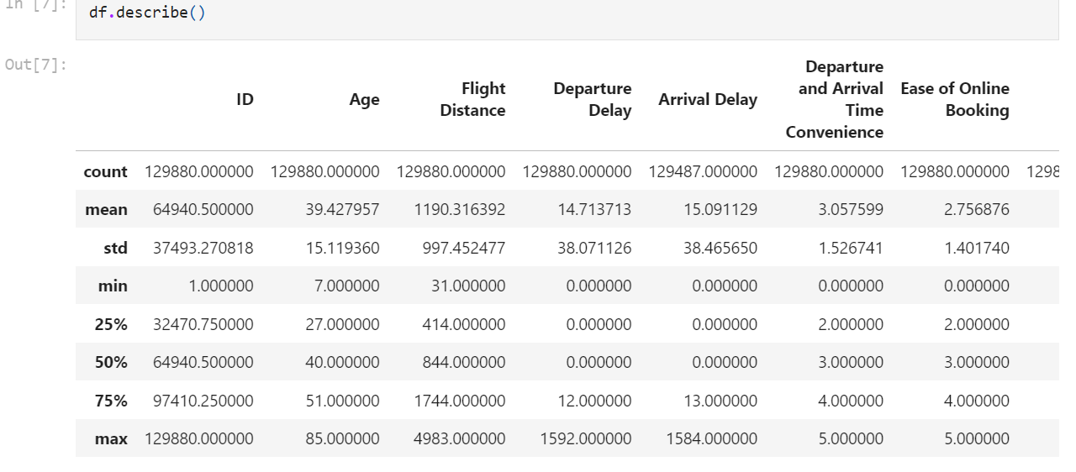
Basic analysis
The dataset consists of 24 columns and 129488 records.
No Null Values and data is clean
satisfaction column is nominal data.
In-flight Entertainment column is ordinal data

Slide 6
Why passenger satisfaction?
Prioritizing passenger satisfaction is essential for airlines to build strong customer relationships, stay competitive, and sustain long-term success in the dynamic aviation industry.

Slide 7
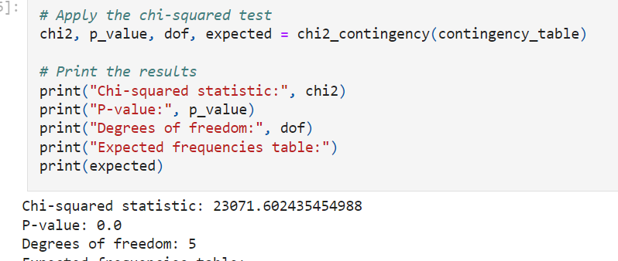
Statistic
Null Hypothesis (Ho): There is no significant relationship between passenger satisfaction and In-flight Entertainment airline service.
Alternate Hypothesis (Ha): There is a significant relationship between passenger satisfaction and In-flight Entertainment airline service.
The null hypothesis (H0) for the chi-squared test :There is no significant association between passenger satisfaction and In-flight Entertainment airline services.

Slide 8
Conclusion
The analysis of airline passenger satisfaction over In-flight Entertainment services
using the Airline Quality Ratings dataset has provided valuable insights
into the relationship between passenger satisfaction and this specific
aspect of airline services.
The research aimed to determine if there was a statistically significant association between passenger satisfaction and In-flight Entertainment services, with the null hypothesis stating that there was no significant relationship, and the alternative hypothesis proposing the existence of a significant relationship.

Slide 9
Conclusion
Through the chi-square test for independence, it was found that the p-value was extremely low (p < 0.05), indicating a statistically significant association between passenger satisfaction and In-flight Entertainment services. This suggests that In-flight Entertainment plays a crucial role in influencing passenger satisfaction levels.
In conclusion, the findings underscore the significance of In-flight Entertainment services in shaping passenger satisfaction and emphasize the importance for airlines to prioritize and invest in this aspect of their offerings to ensure a positive passenger experience and maintain a competitive edge in the aviation industry

